Slide 1

AI DRIVEN INSIGHTS: UNDERSTANDING EDUCATIONAL PATTERNS THROUGH VISUALIZATION AND ANALYTICS
Final Year Project - I
Presenter: Hamna Qaseem
Supervisor: Dr. Muhammad Ateeq
(F20BDATS1E01012)
Group ID: MA-1
Date: 24/12/2024
Department of Data Science
The Islamia University of Bahawalpur

Slide 2
Agenda
Introduction
Background
Problem Statement
Methodology
Data and Analysis
Data Collection/ Preprocessing
Exploratory Data Analysis (EDA)
Dashboard Development
Demo: Streamlit Dashboard
Conclusion & Next steps

Slide 3
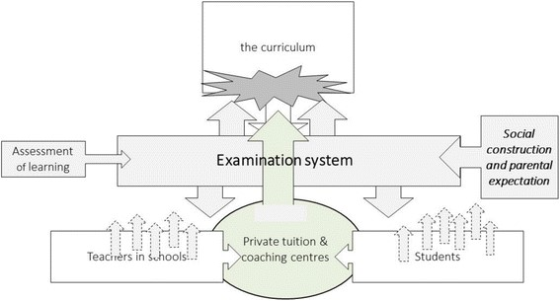
Introduction
In the ever-evolving trend of education, examinations stand as crucial milestones that shows the progress and proficiency of learners. From the foundational assessments in early childhood education to the pivotal board examinations in higher education, the examination system forms the backbone of educational evaluation. In this project We're diving into exam details, focusing on (SSC) results for valuable insights.

Slide 4
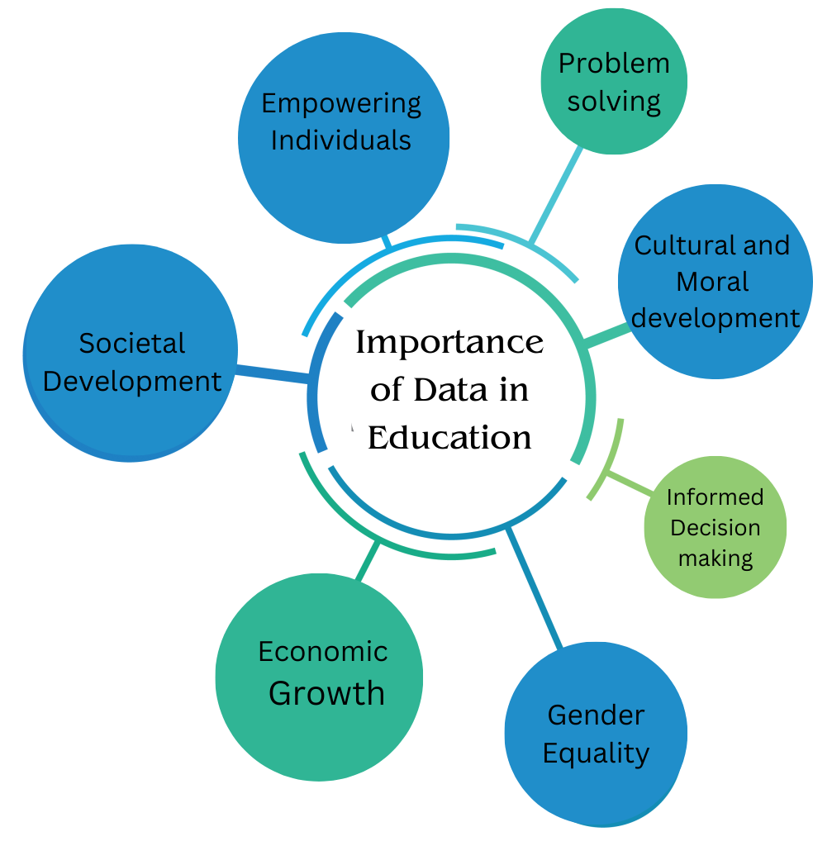
Background Importance of data in education
Educational data is very important specially the
examination result data used for the evaluation
of trends and performances.
It empowers individuals to contribute to
economic growth, social cohesion, and global competitiveness, making it a cornerstone
for positive change and development.

Slide 5
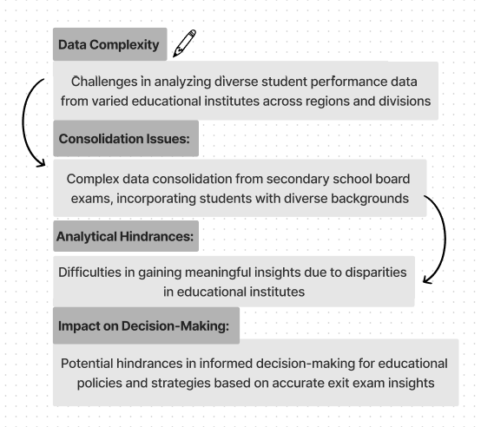
Problem Statement

Slide 6



Objective of study
Performance
Strategic Analysis: Use EDA and statistical models to address educational disparities in exam results.
In-Depth Insights: Understand enrollment trends, subject challenges, and gender differences comprehensively.
Our Objective
Development
As a key outcome, we plan to develop a user-friendly dashboard. This dashboard will serve as a powerful tool, offering a visual representation of the analyzed data.
Goal
Our aim is to facilitate stakeholders in making informed decisions, leading to positive changes in educational policies and strategies.
6

Slide 7
Related Work
Comparability of GCSE Examination (Rasch Model)
Examines difficulties across subjects.
600,000 candidates, GCSE in England.
Subject pair analysis, gender-based insights.
Student Disengagement Analysis (Intelligent Tutoring System)
Explores disengagement in urban, rural, and suburban schools.
Educational software data, demographic insights.
Educational Data Analytics Overview
Utilizes data for insights and improvements.
Predictive analytics for better decision-making.
Need for implementation, strategies, and potential benefits.

Slide 8
Project Alignment with Related Work
- Board Exam Focus:
Uniqueness: Centers on SSC results, exploring distinct patterns in secondary education.
- Comprehensive Data Analysis:
Uniqueness: Offers holistic insights, covering enrollment trends, subject challenges, and gender differences concurrently.
- User-Friendly Dashboard:
Innovation: Presents accessible insights, empowering stakeholders with intuitive decision-making tools.
- Future Predictions with Machine Learning:
Innovation: Implement machine learning for proactive future trend predictions, going beyond descriptive analysis.

Slide 9
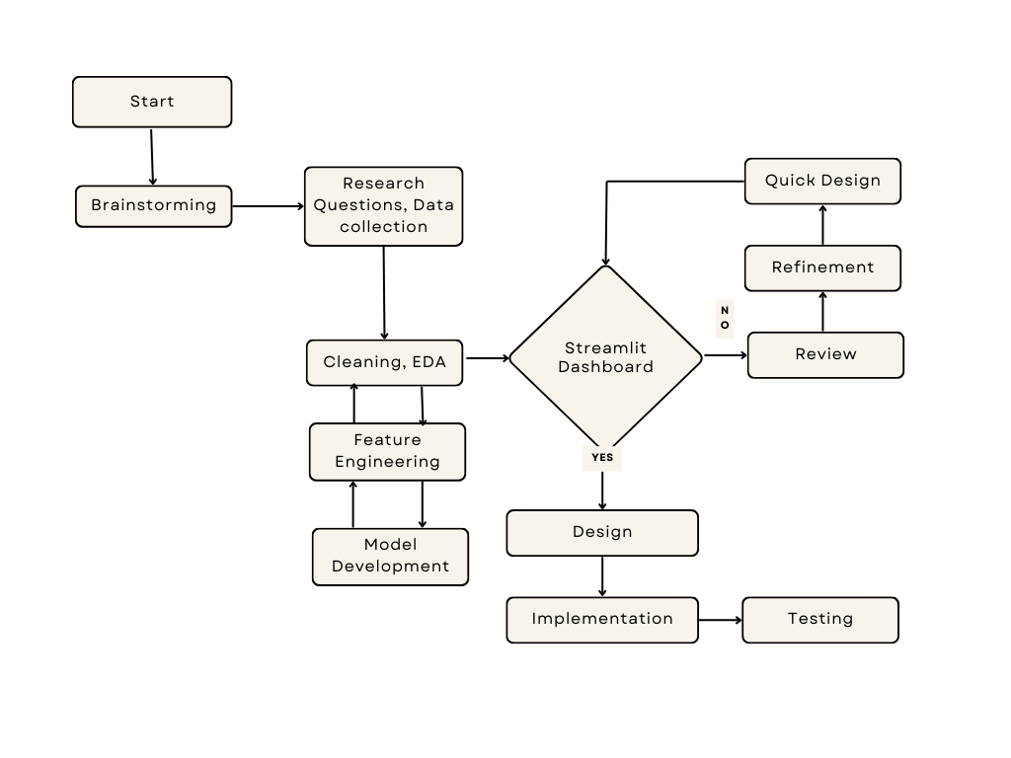
Methodology
Our methodology involves
Define Research Questions
Data Collection
Data Preprocessing
Data Analysis
Dashboard Development
Predictive Modeling
Refinement & Feedback
Concise Reporting
Dashboard Implementation
Conclusion & Recommendation

Slide 10
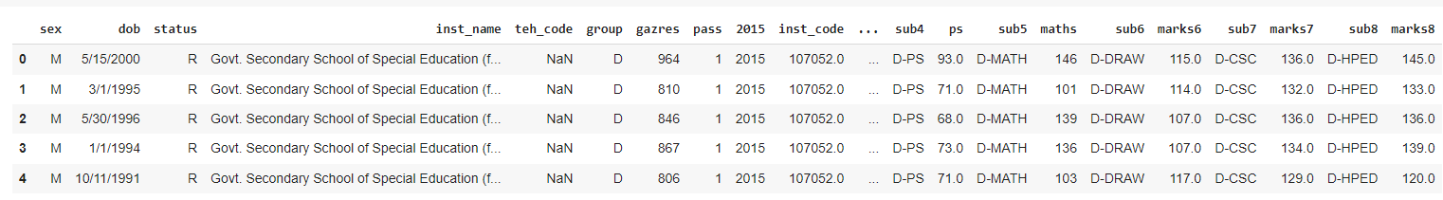
1. Data Collection
Successfully contained student’s ssc exam result data of board examination covering years from 2015 to 2023.
Dataset overview

Slide 11
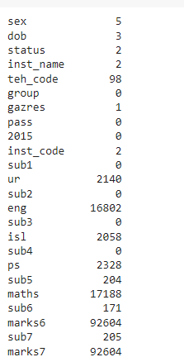
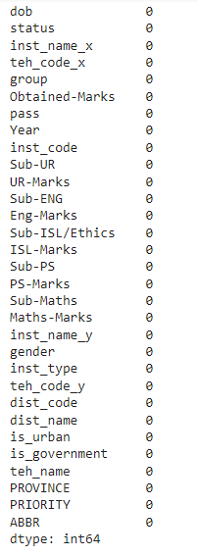

2. Data Wrangling
Columns with Missing values
Columns after
handling missing values
Handled data quality and consistency as
we processed and prepared the dataset
for further analysis.
Apply mean imputation for numerical
columns and mode for categorical
features.

Slide 12
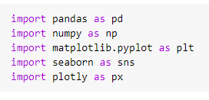


3. Exploratory Data Analysis
Data Exploration & Visualization Techniques
Importing Libraries
Exploring the dataset to identify patterns, trends, and outliers through statistical and visual methods. Utilizing various visualization methods such as charts, graphs, and maps to represent educational trends.

Slide 13
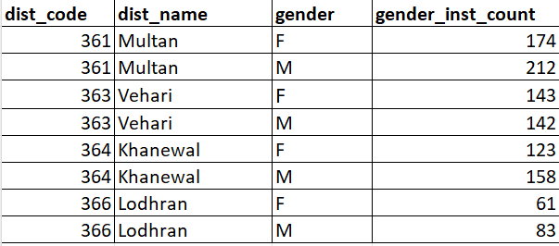
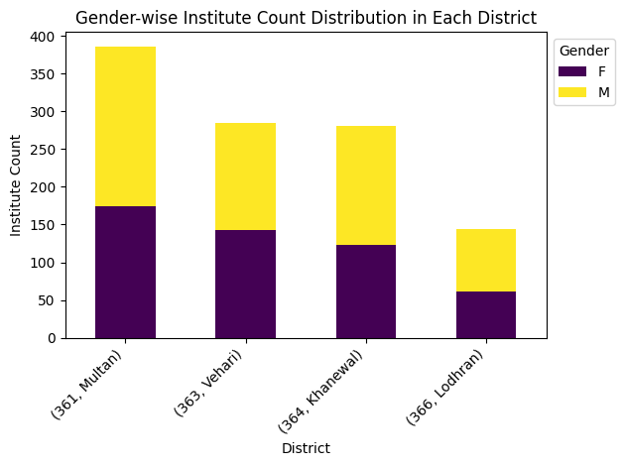
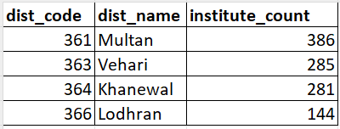
Results from our Insights
Count of gender wise Institutes in each Districts
How does the academic performance vary across different regions (tehsils) and educational institutions?
In year 2015, we observed that Multan had the most institutes, while Lodhran had fewer, highlighting differences in education across districts.
Count of total Institutes in each Districts

Slide 14
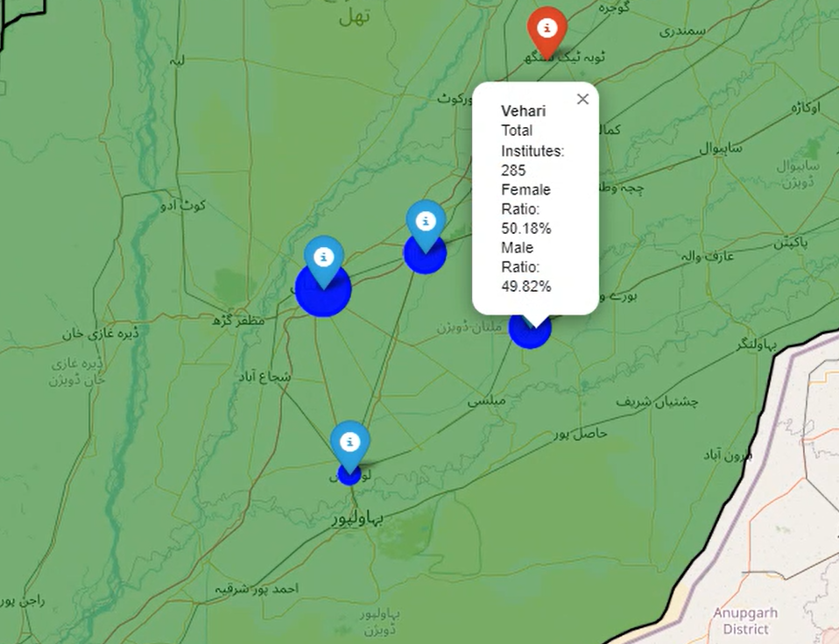
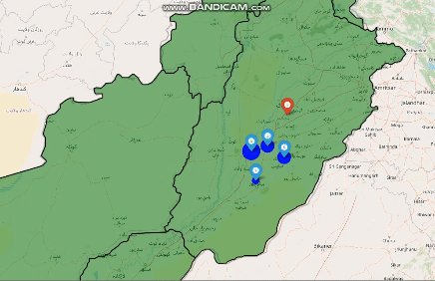
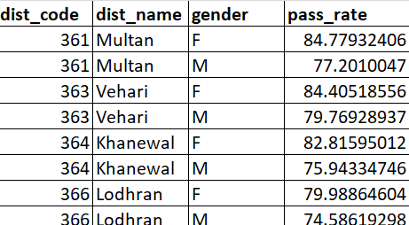
District-wise Passing rate Year-15: A Visual Exploration through Map
Vehari with
higher passing rate
with both gender
This Map is pointing the districts in
Punjab province along with passing
rate of each gender in each district.

Slide 15
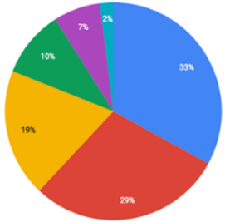
Let’s discuss some snapshots from our study
BAR plot
Histogram
Pie chart

Slide 16


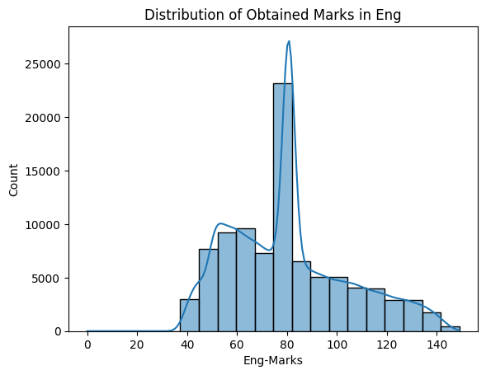
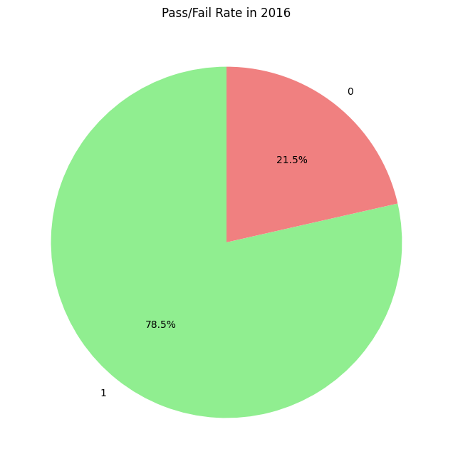
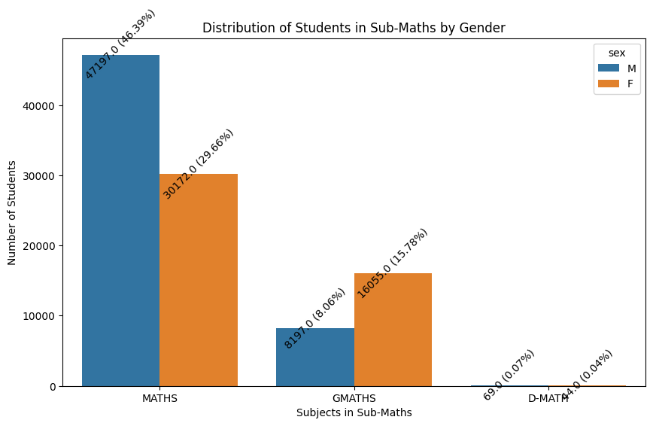
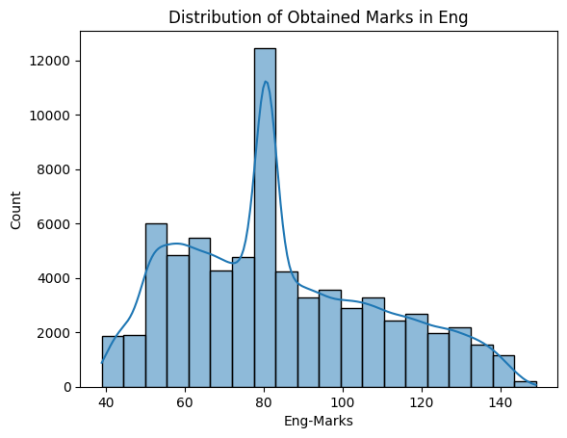
This bar graph is showing the distribution of students in Maths subject count wise.
D -- Deaf and dumb group
We can easily identify the highest count of group. In this figure, we can see we have higher number of Maths group students from Male gender in year 2016 data.
In this histogram chart, we can
see the distribution of obtained marks of students in english subject.
From our study, we can see the students having marks higher in the range of 80’s.
With the help of pie chart
we can easily see the passing/fail
ratio of students.
In our study, it can see that we have
78.5% of students with pass rate and
fail rate was 21.5%.

Slide 17
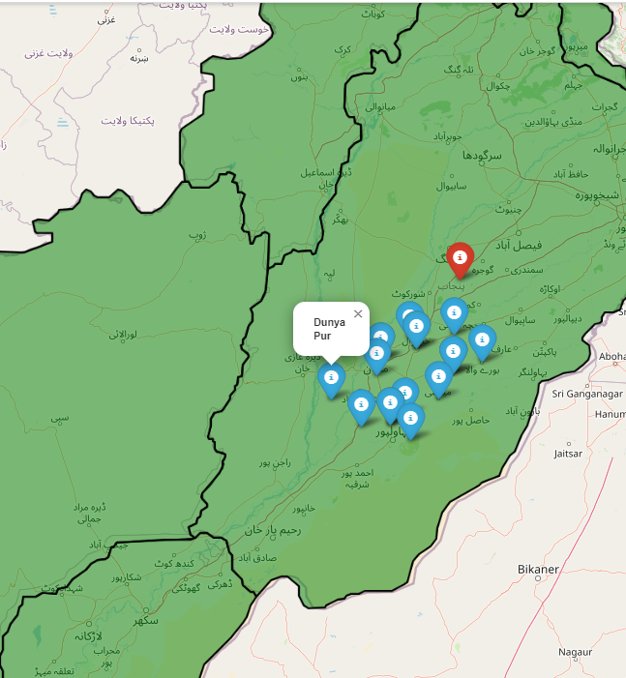

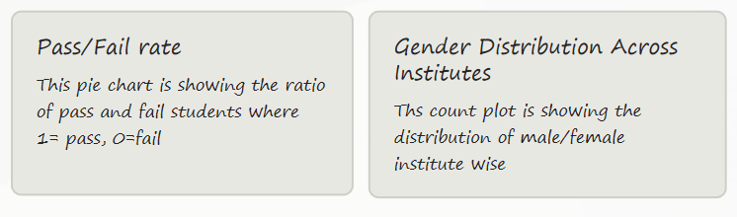
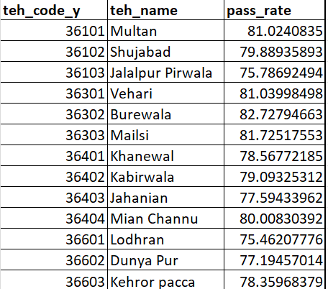
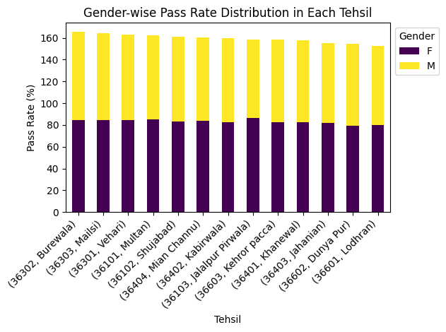
TEHSIL WISE PASS RATE
This stacked bar is showing the distribution of students across each tehsil along pass rate
This table is showing the passing rate of students across each tehsil

Slide 18
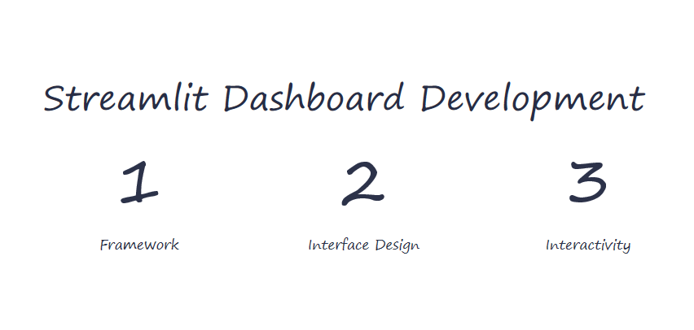

Slide 19

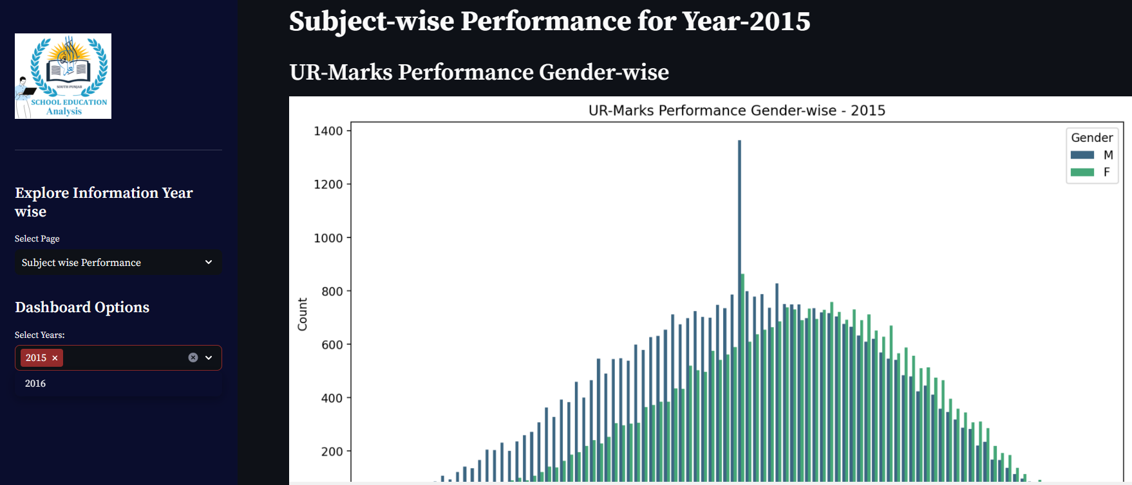
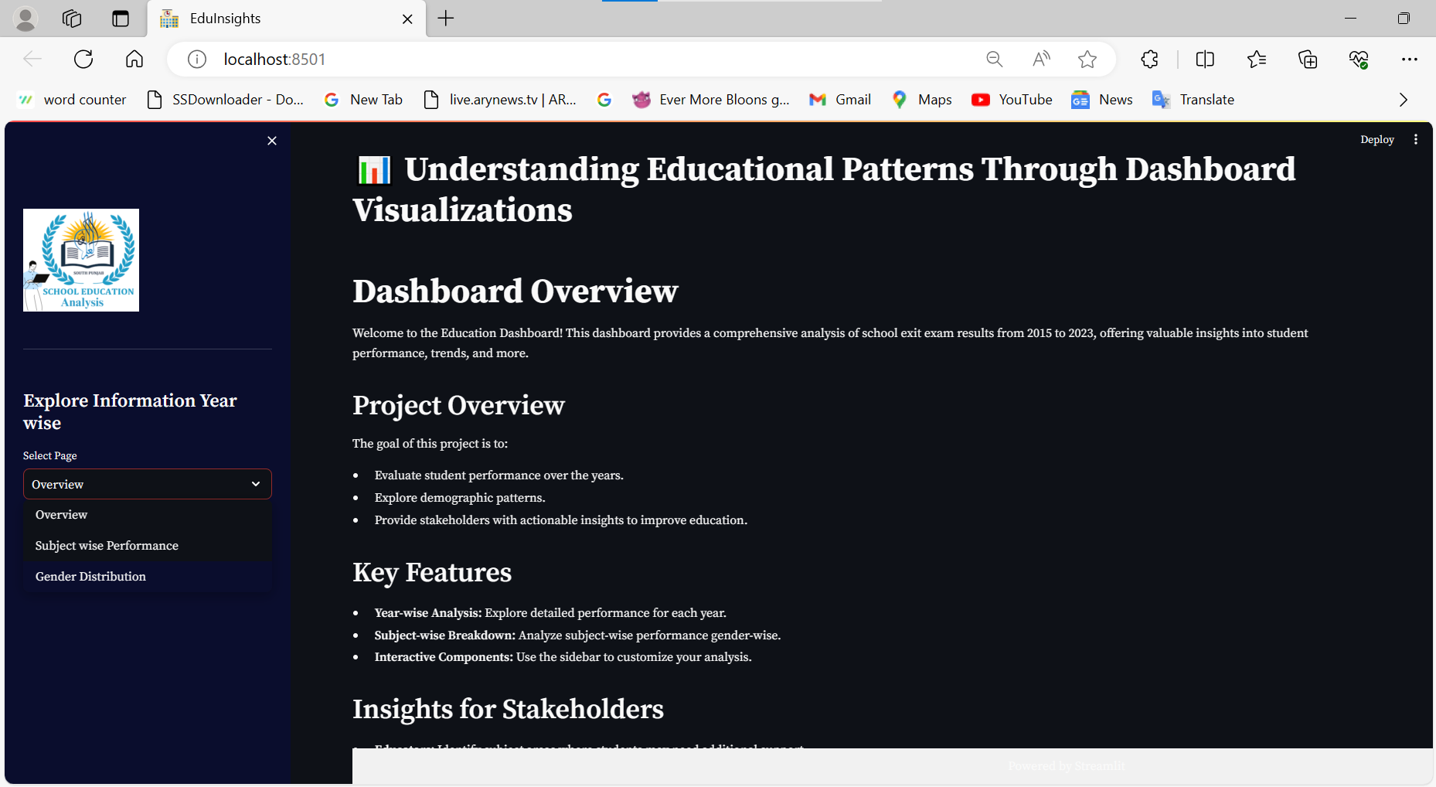
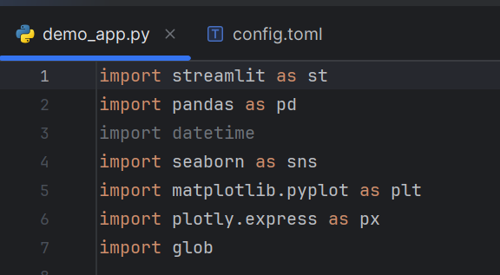
Develop the Streamlit app script, embedding visualizations, and interactive components.
This is the demo main page of streamlit app, next steps are required to make it more user interactive
For now our dashboard is showing performance on user call year dataset

Slide 20
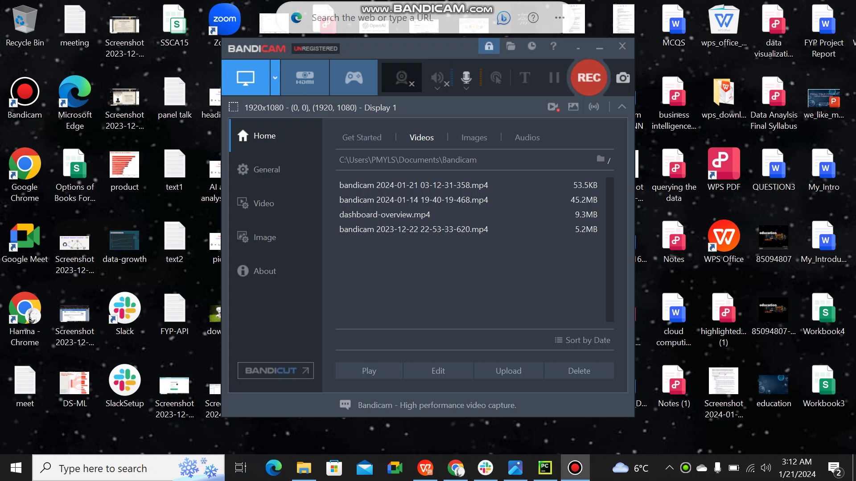
DEMO VIDEO OF DASHBOARD

Slide 21
Dataset Acquisition
Successfully obtained students' SSC result data from the examination board, covering the years 2015 to 2023.
.
Data Wrangling
Applied research questions on datasets from 2015, 2016, and 2017.
Handled data quality and consistency as we processed and prepared the dataset for further analysis.
StreamlitDashboard
Populated visuals and insights for the years 2015, 2016, and 2017, creating a foundation for the comprehensive dashboard.
Machine Learning
Model development phase not initiated. Next work involves utilizing machine learning techniques to gain deeper insights from the educational data.
30%
30%
0%
100%
Iteratively refine methodologies by ensuring the project aligns with evolving educational landscapes. Maintaining data integrity and analytical precision requires the implementation of strong quality assurance procedures.
PROJECT TIMLINE
(progress summary)
Dataset building
Data preprocessing/Analysis
Dashboard Development
Model Development

Slide 22
Conclusion
In conclusion, our project has offered valuable insights into the educational landscape, particularly in the context of Board of Secondary Examination (SSC) results. The comprehensive analysis is shedding light on enrollment trends, subject-specific challenges, and gender-based differences. The user-friendly dashboard provides stakeholders with intuitive tools for informed decision-making.
Next Steps:
As we move forward, the next steps involve further EDA steps, refining predictive models, incorporating machine learning for future trend predictions, and further enhancing the interactive dashboard.

Slide 23
THANK YOU!

